Slide 1

Silicon Prairie Gencyber
Student Camp Recap

Slide 2
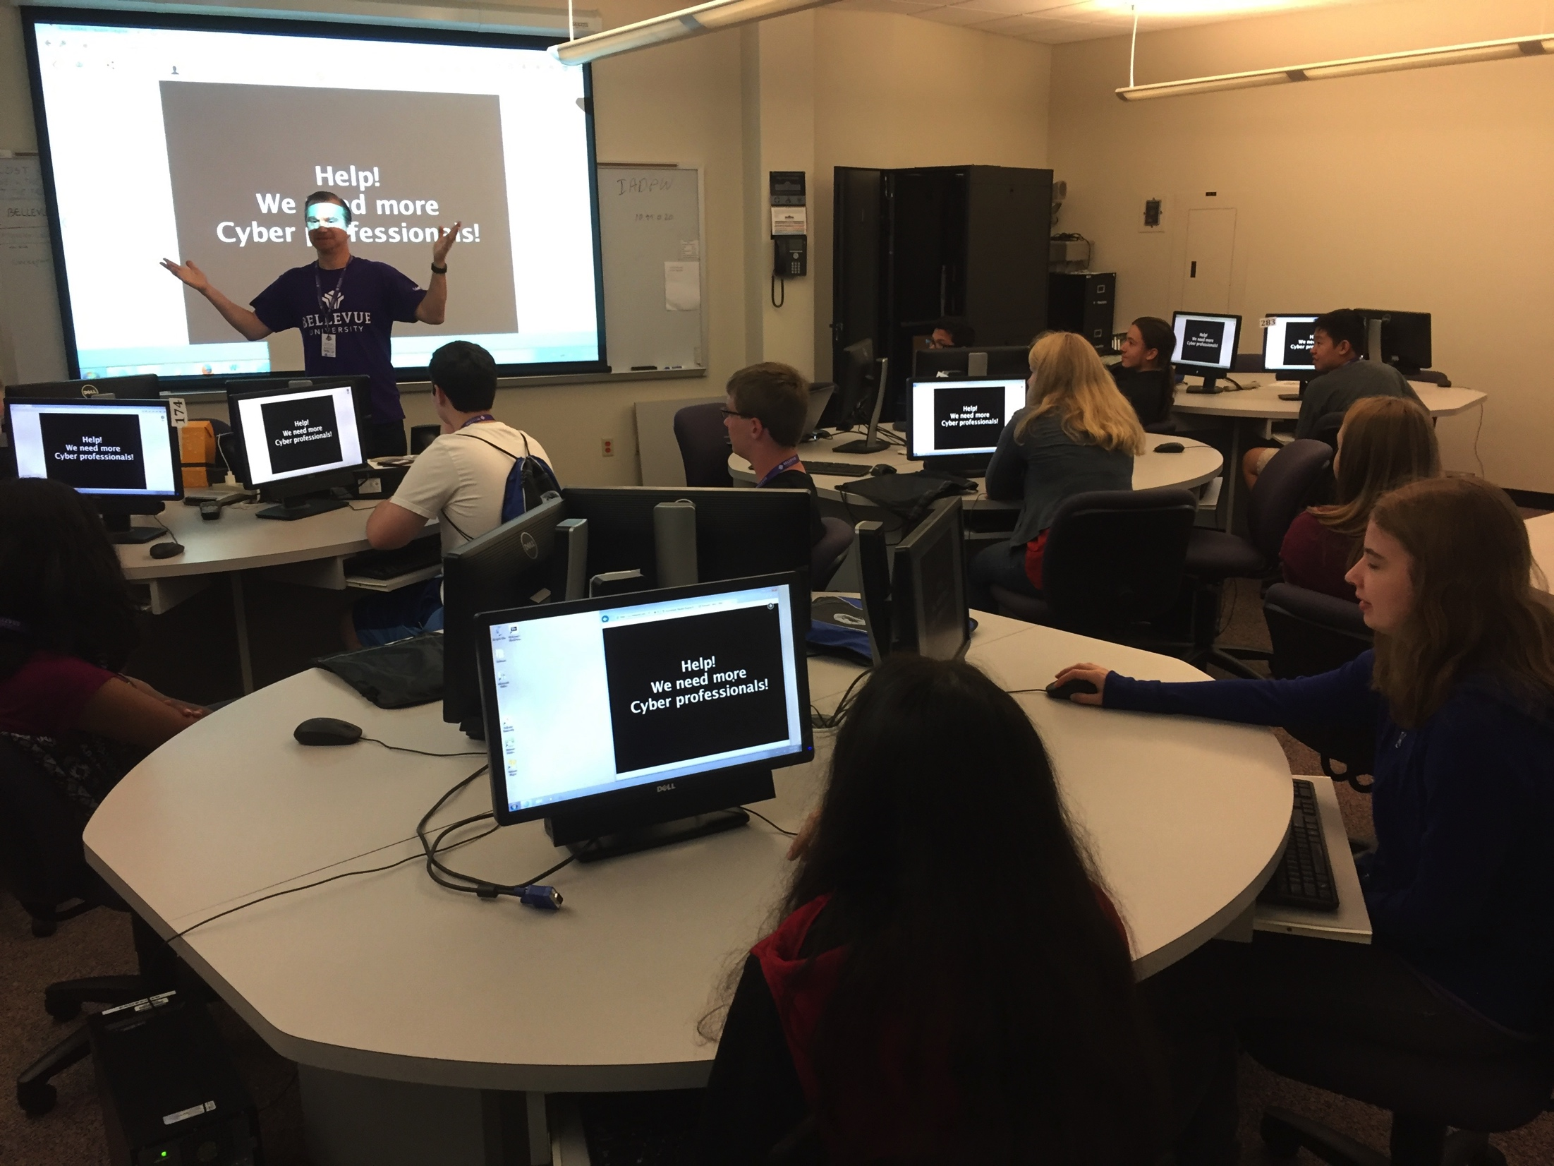

Slide 3
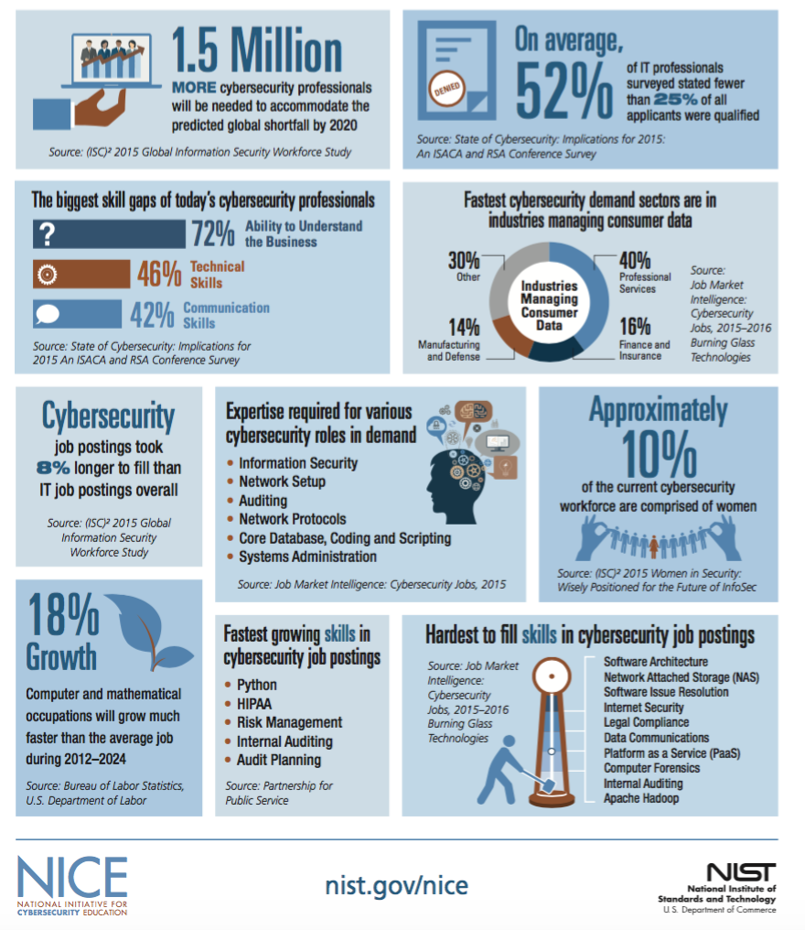

Slide 4
Typical Student Camper
There wasn’t one

Slide 5
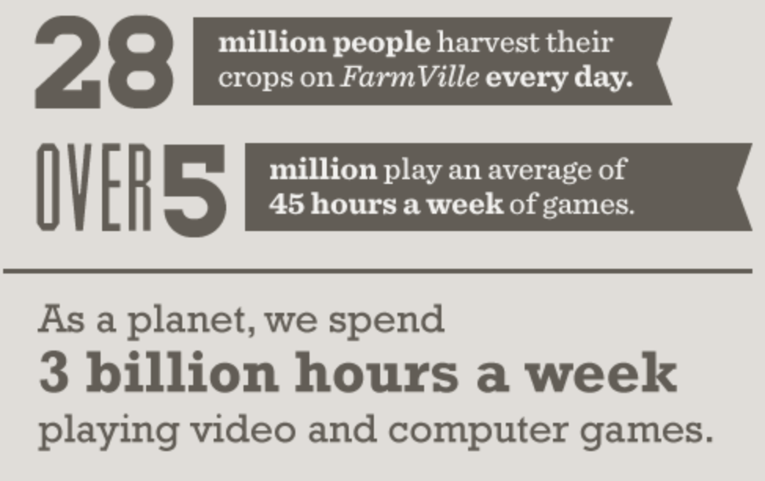

Gamification
*source: Knewton.com

Slide 6
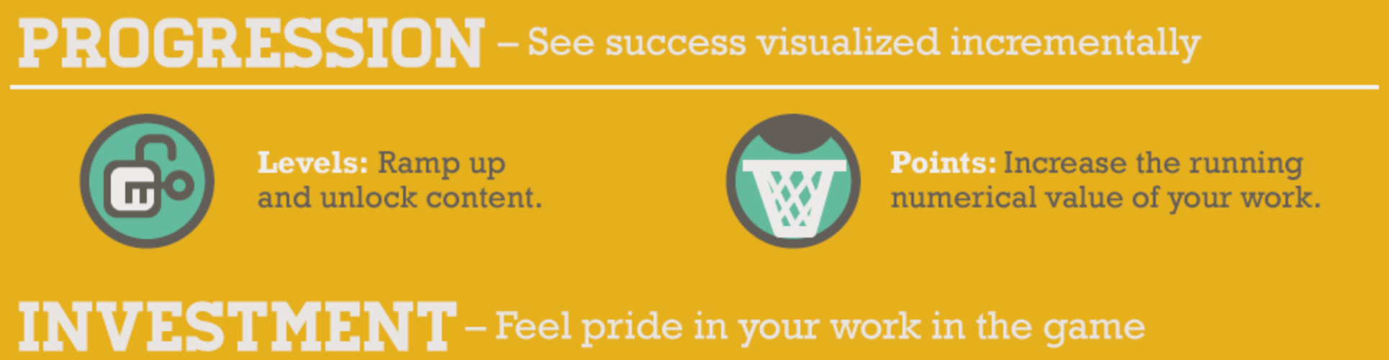
*source: Knewton.com

Slide 7
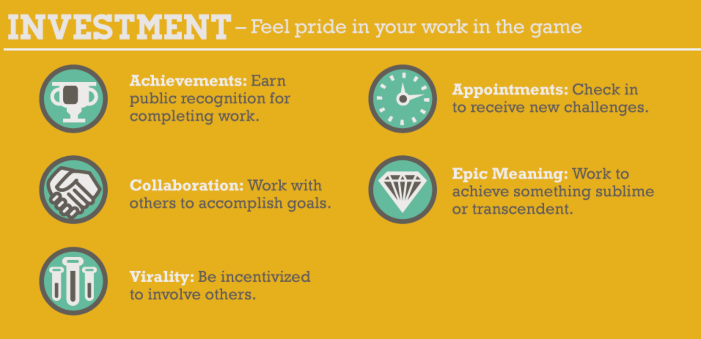
*source: Knewton.com

Slide 8
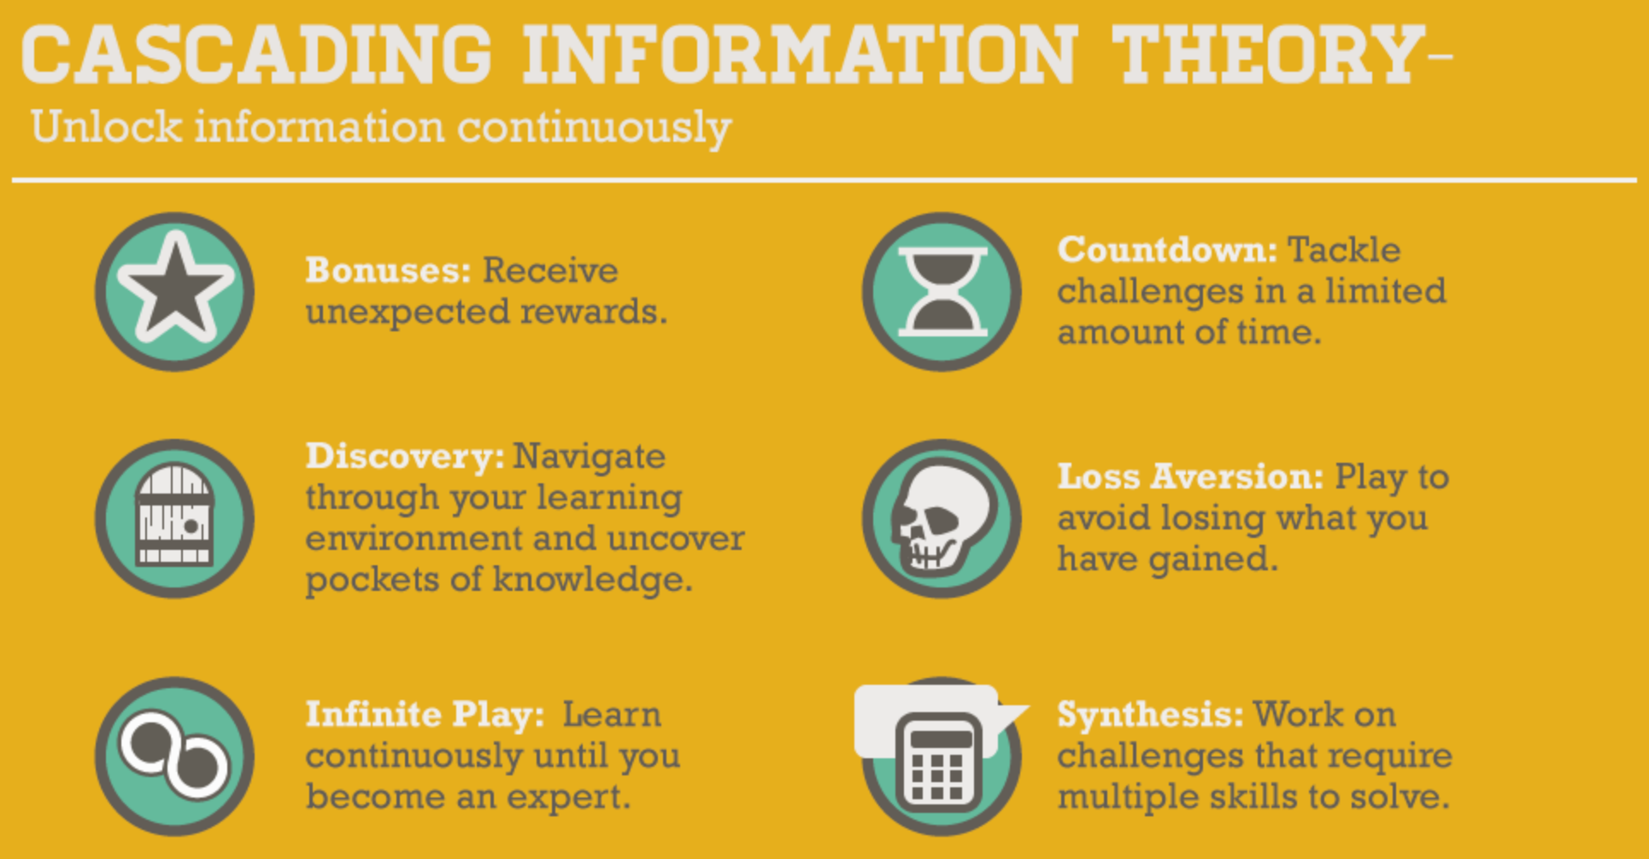
*source: Knewton.com

Slide 9
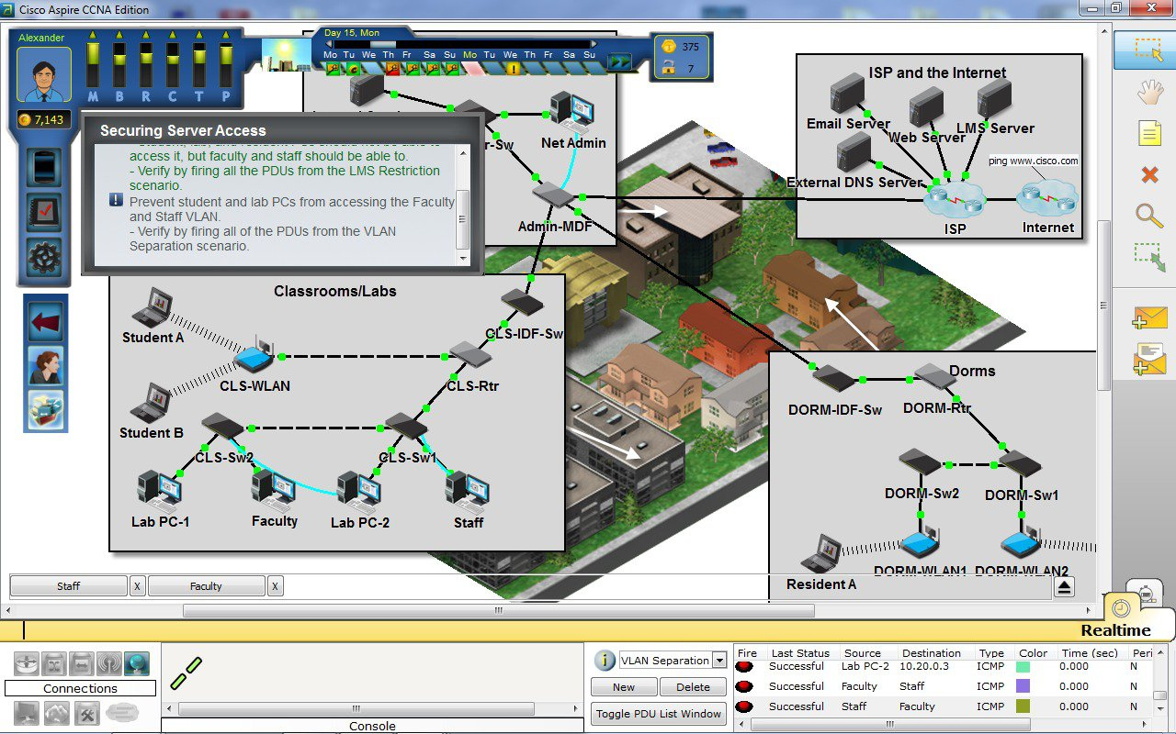
Cisco Aspire

Slide 10
Try This – codecombat.com

Slide 11
Approach
Day 0: Expose – Cyber Careers
Day 1: Build - Security Architect
Day 2: Fix – System and Network Admin
Day 3: Hack – Security Ops
Day 4: Teach – Refine
Day 5: Compete - CTF
No plan survives first contact

Slide 12
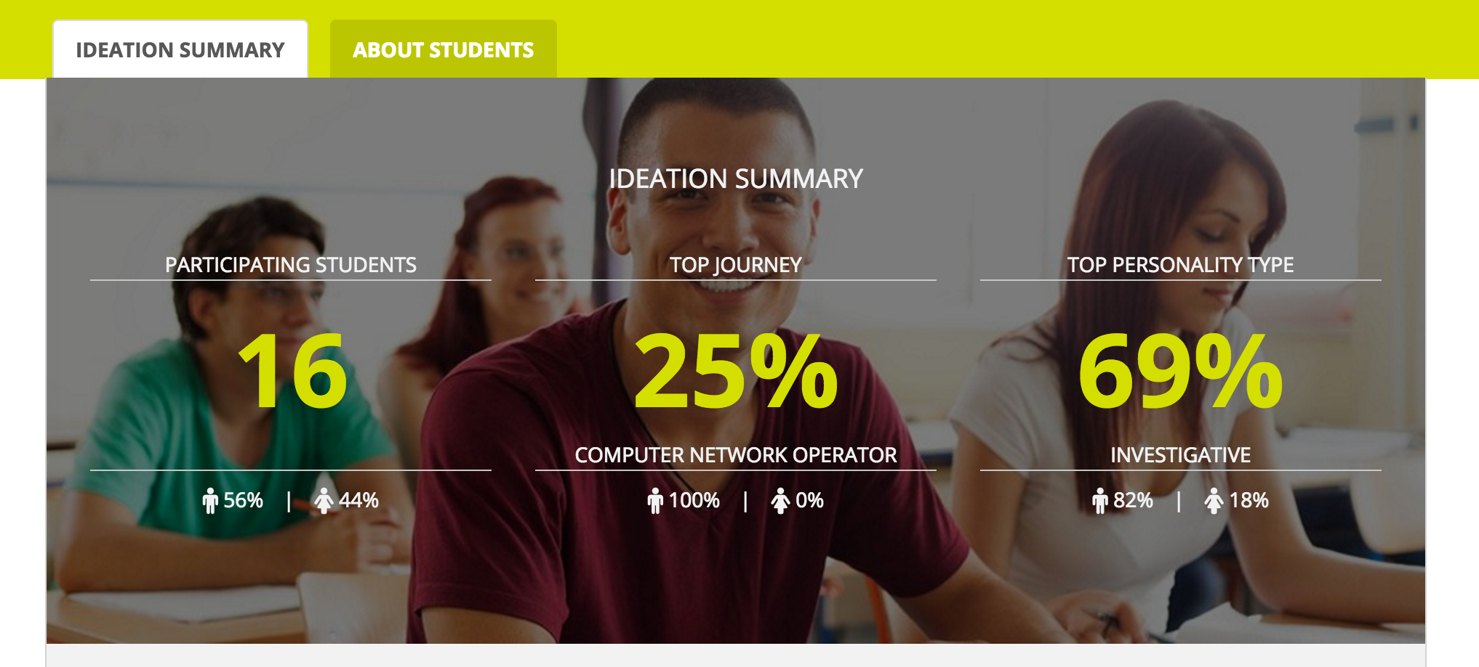
Day of Cyber

Slide 13
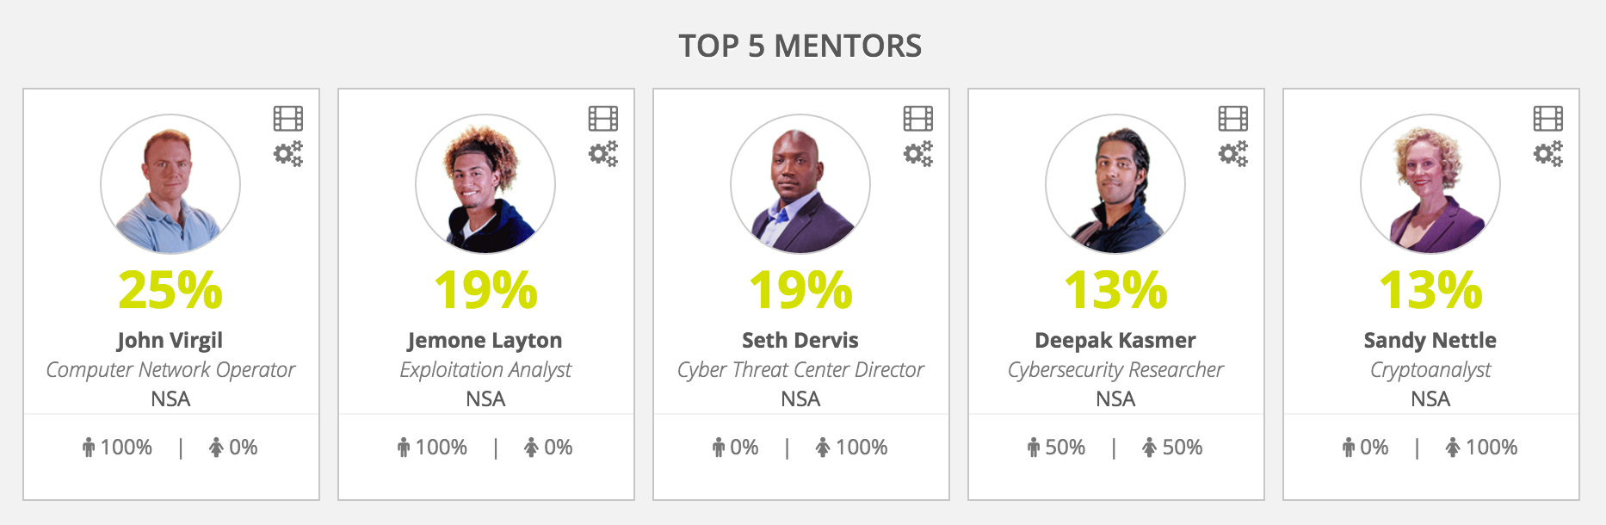
Day of Cyber

Slide 14
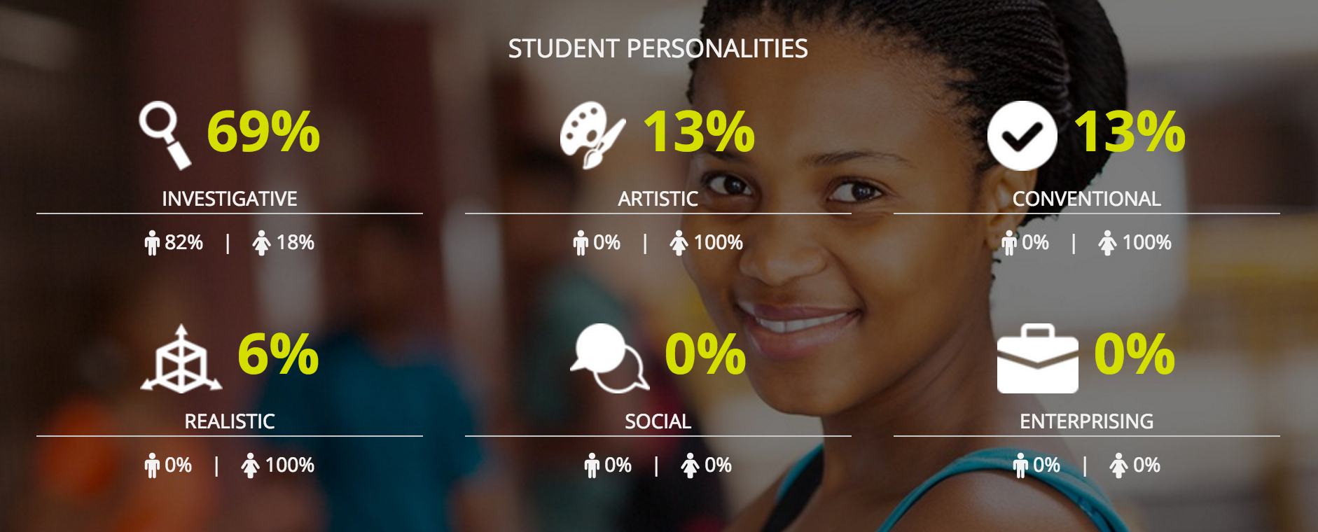
Day of Cyber

Slide 15
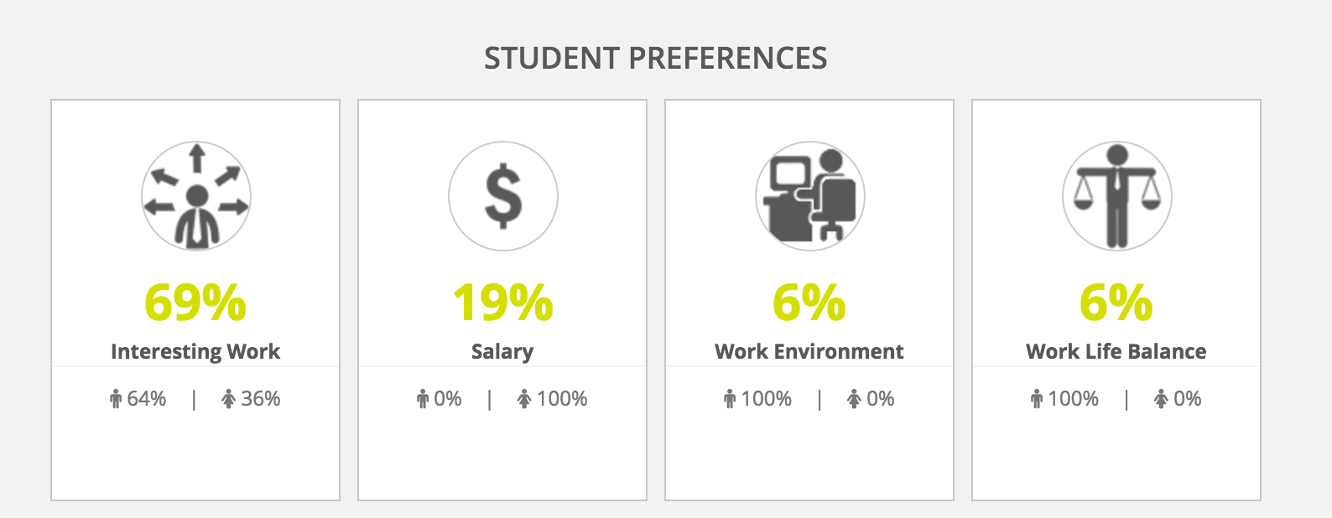
Day of Cyber

Slide 16
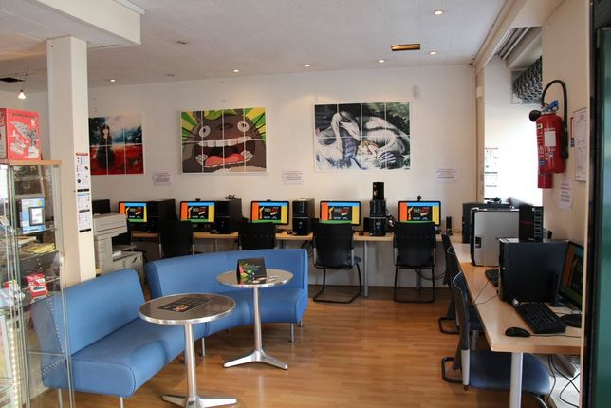
Scenario
Silicon Prairie Cafe

Slide 17
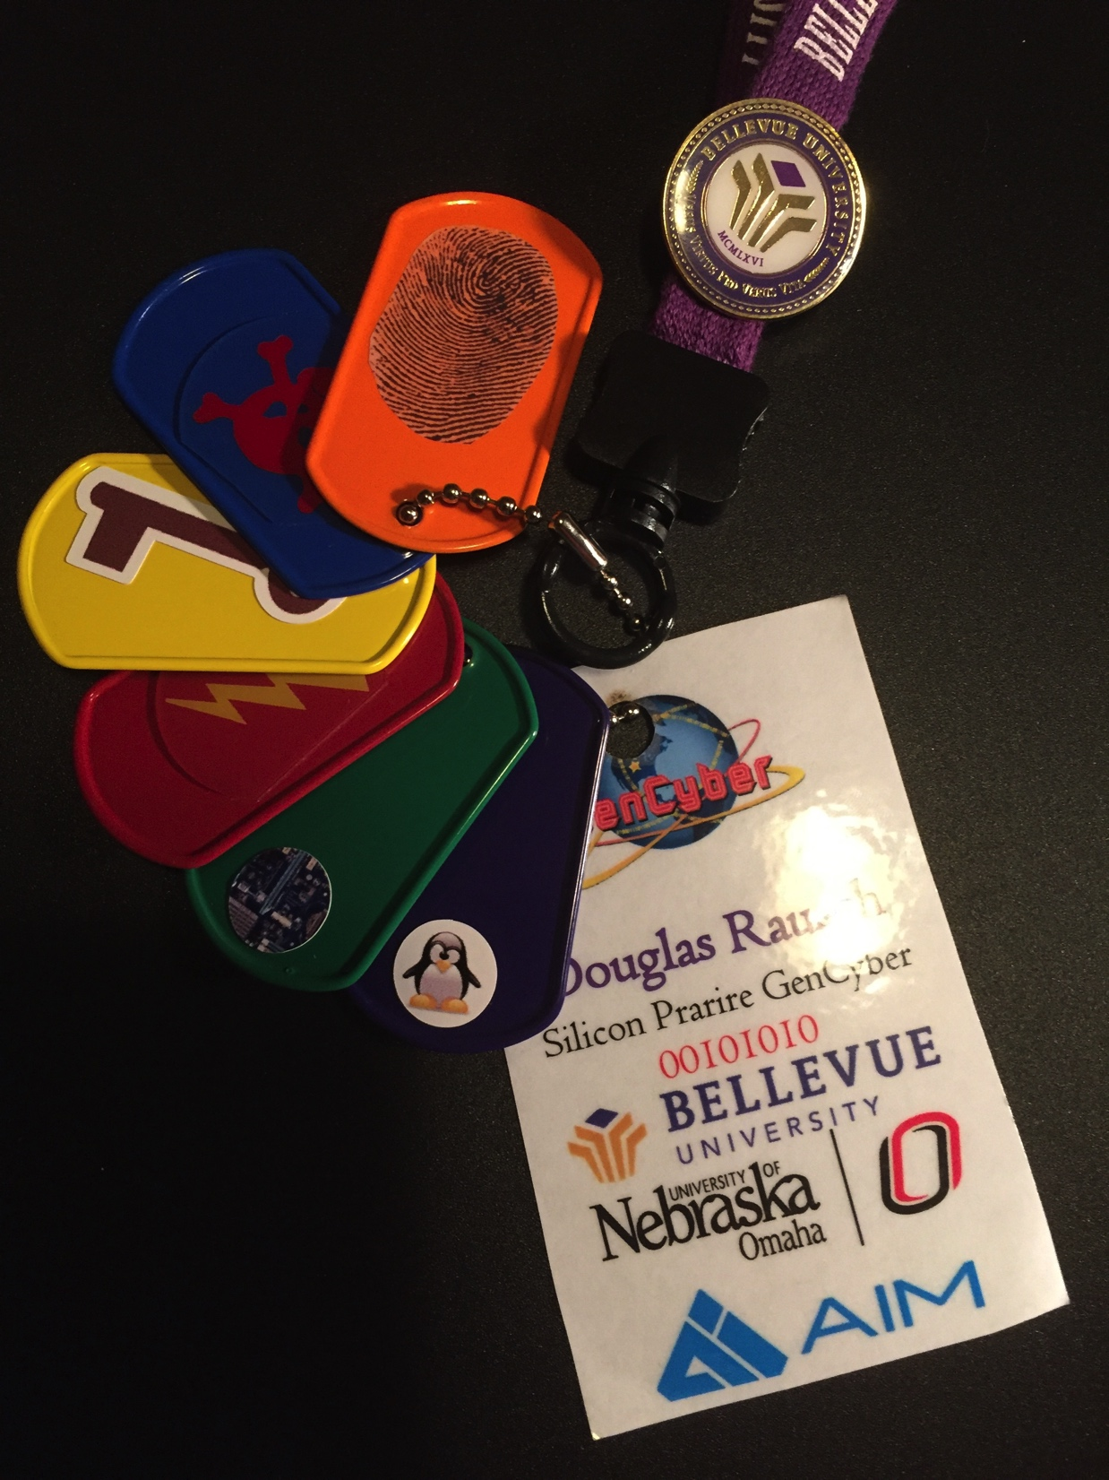
Certification Badges
Orange: Forensics
Blue: Malware
Yellow: Cryptography
Red: Networking
Green: Hardware
Purple: Linux

Slide 18
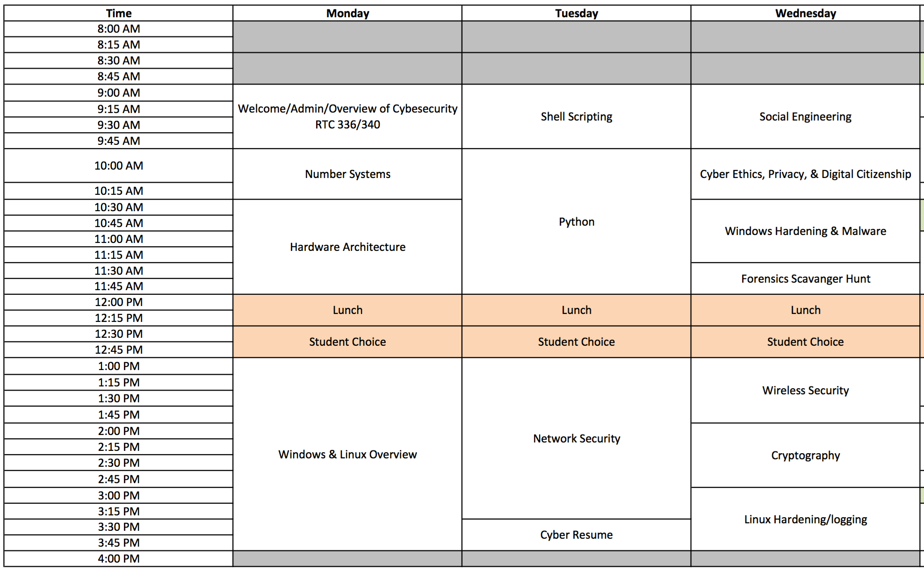
Schedule

Slide 19
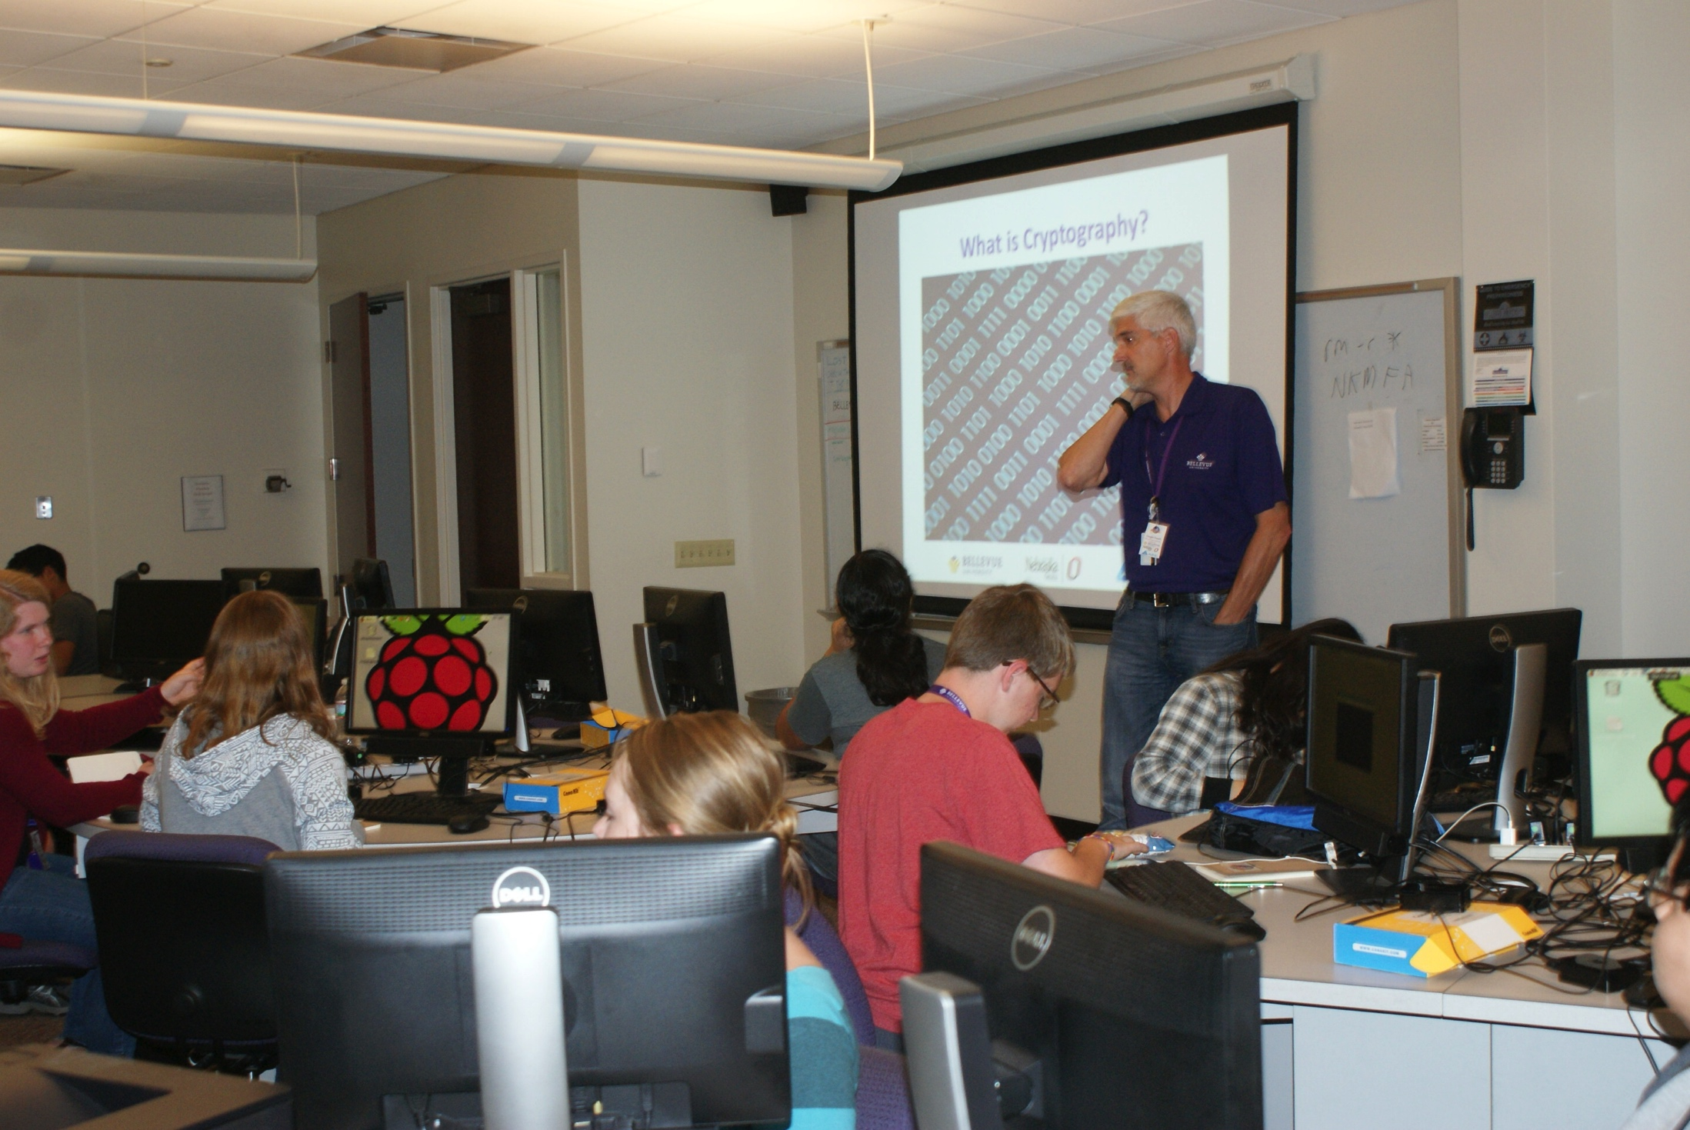
Some Lecture, but…

Slide 20
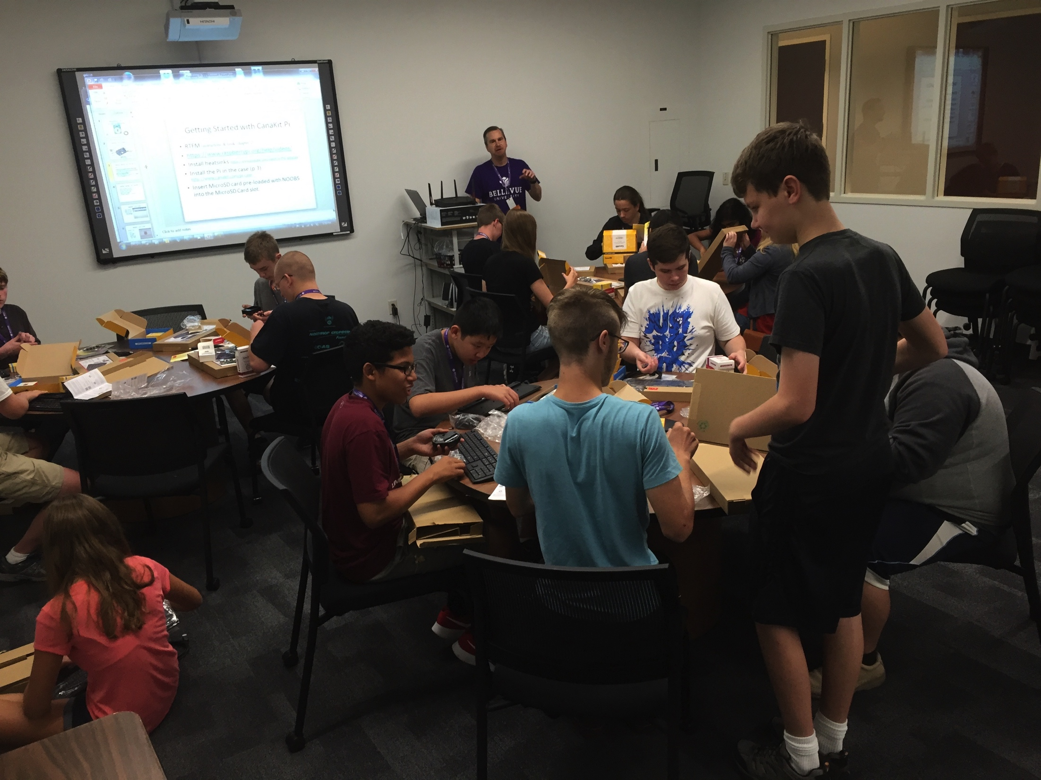
Even more hands on

Slide 21
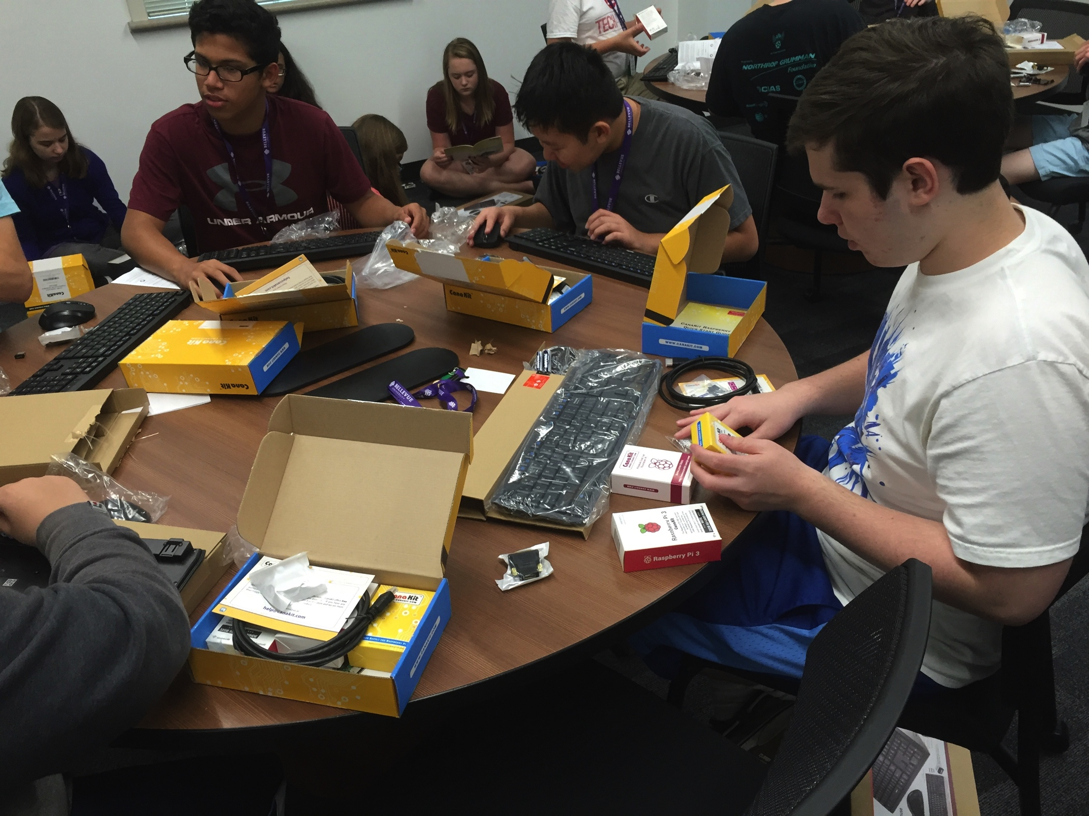

Slide 22
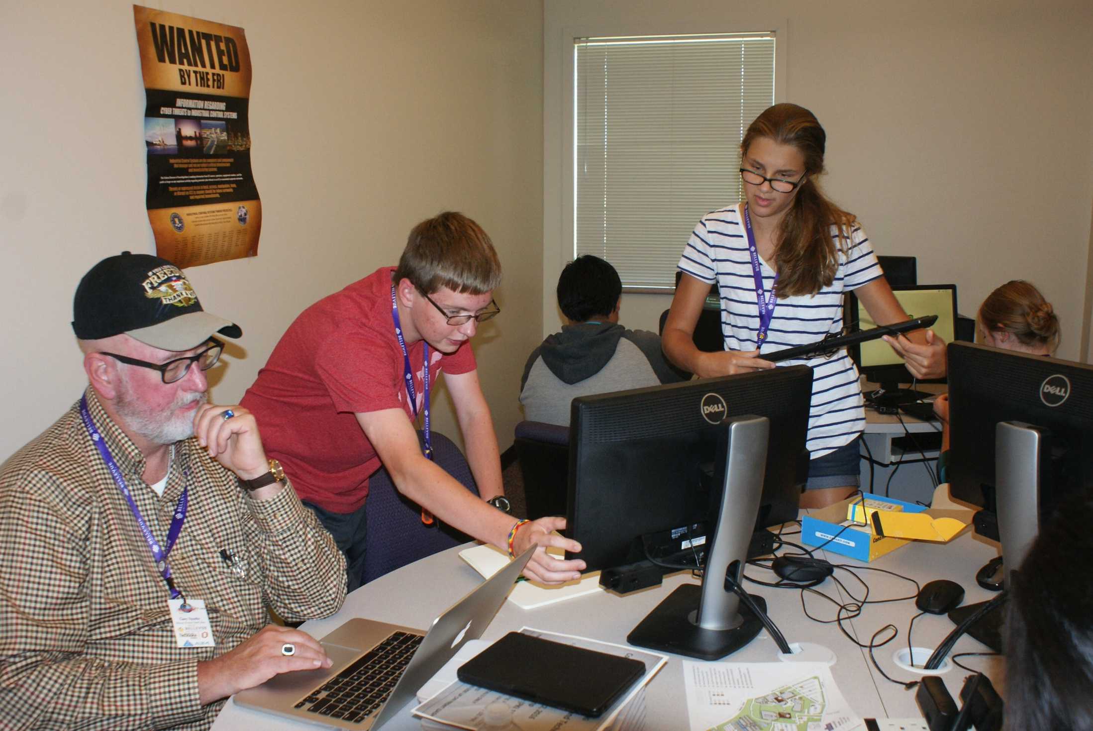
Lots of one on one

Slide 23
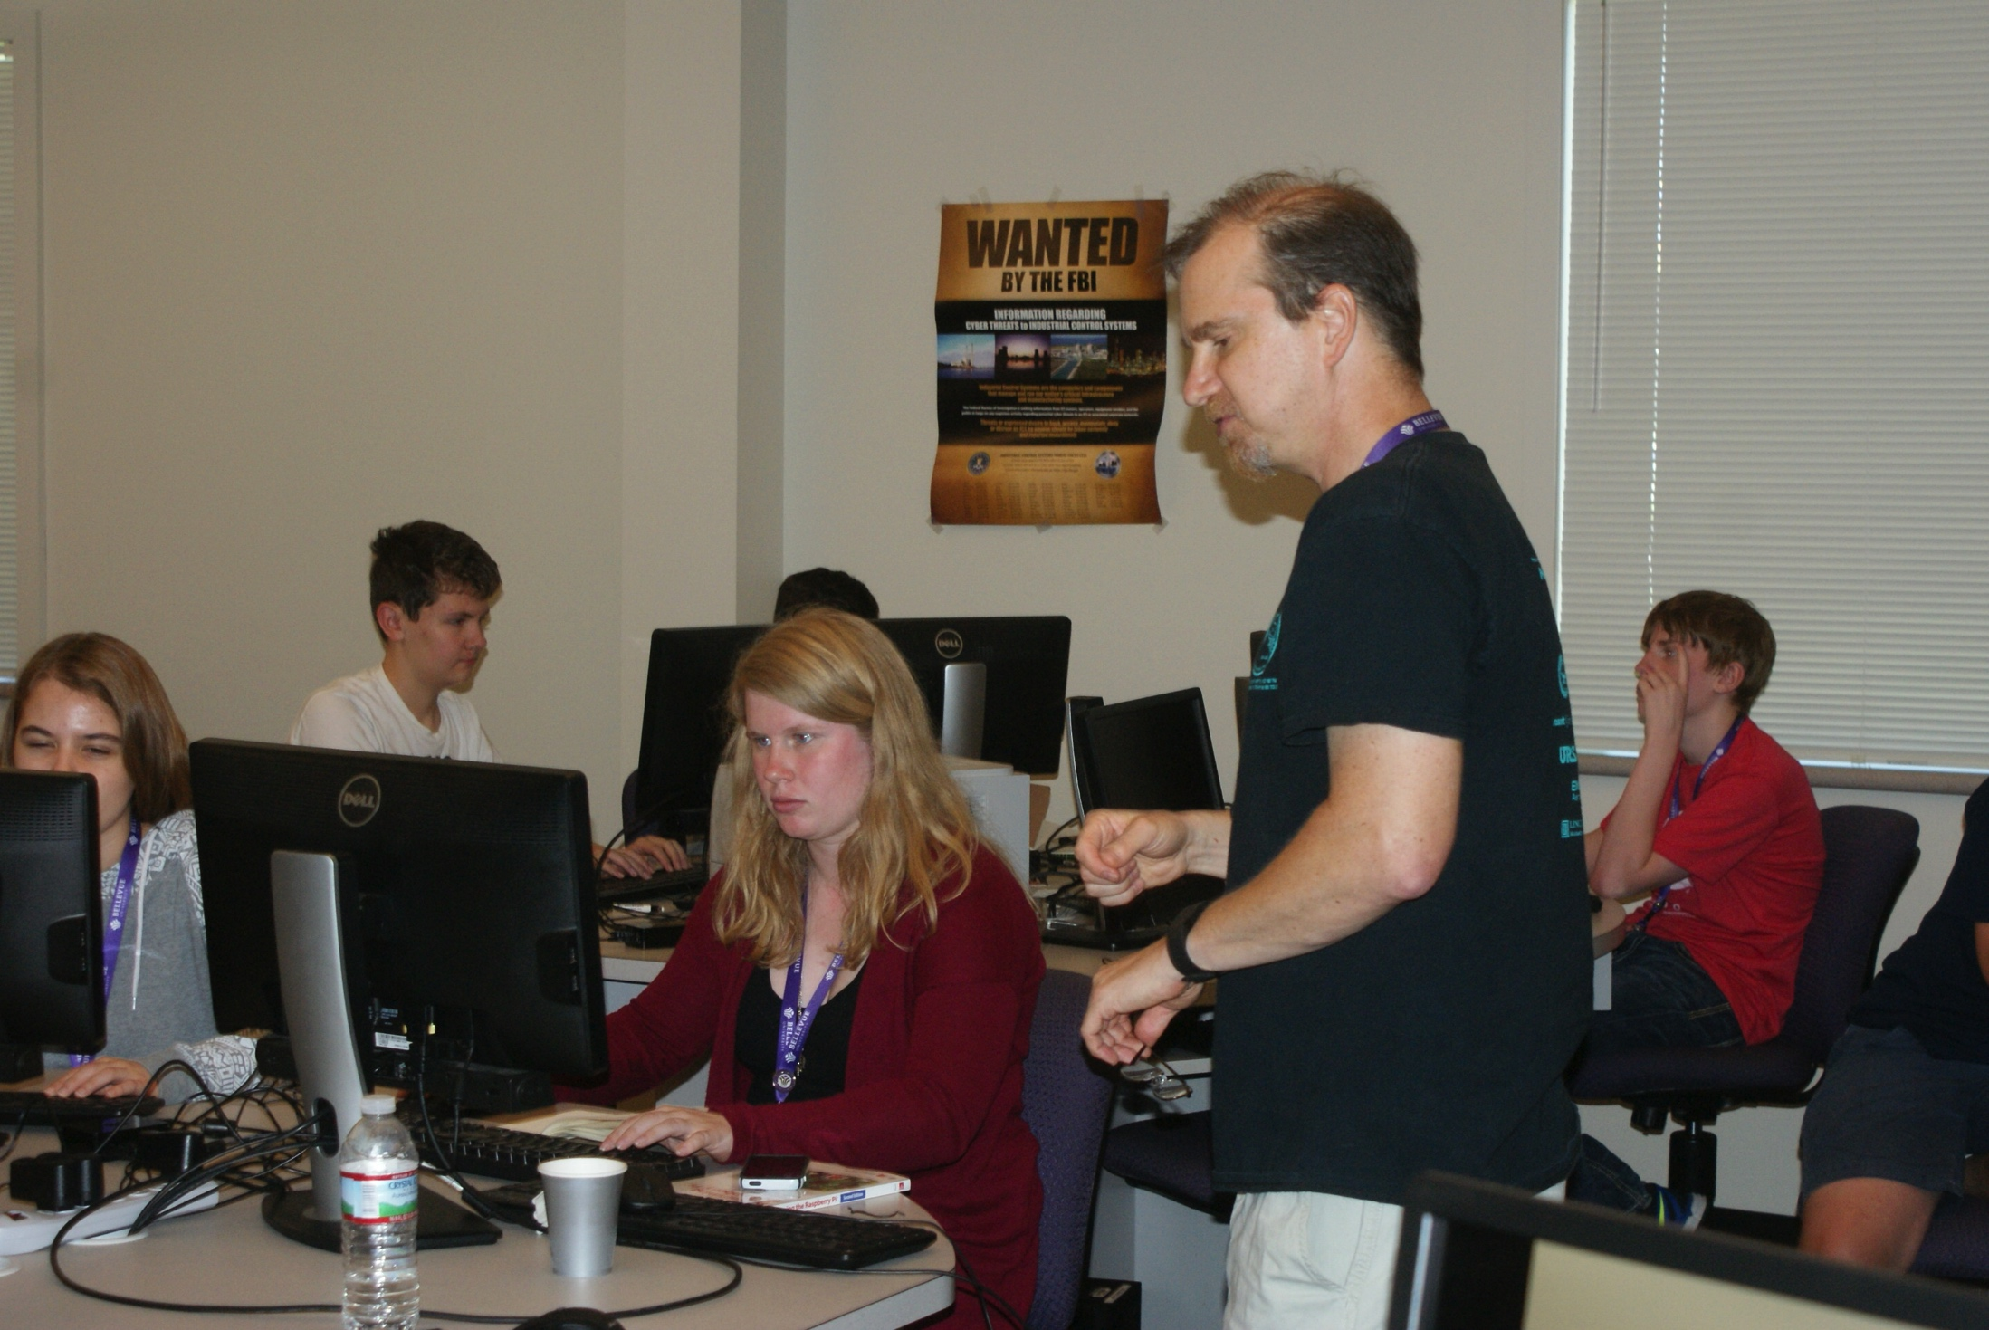

Slide 24
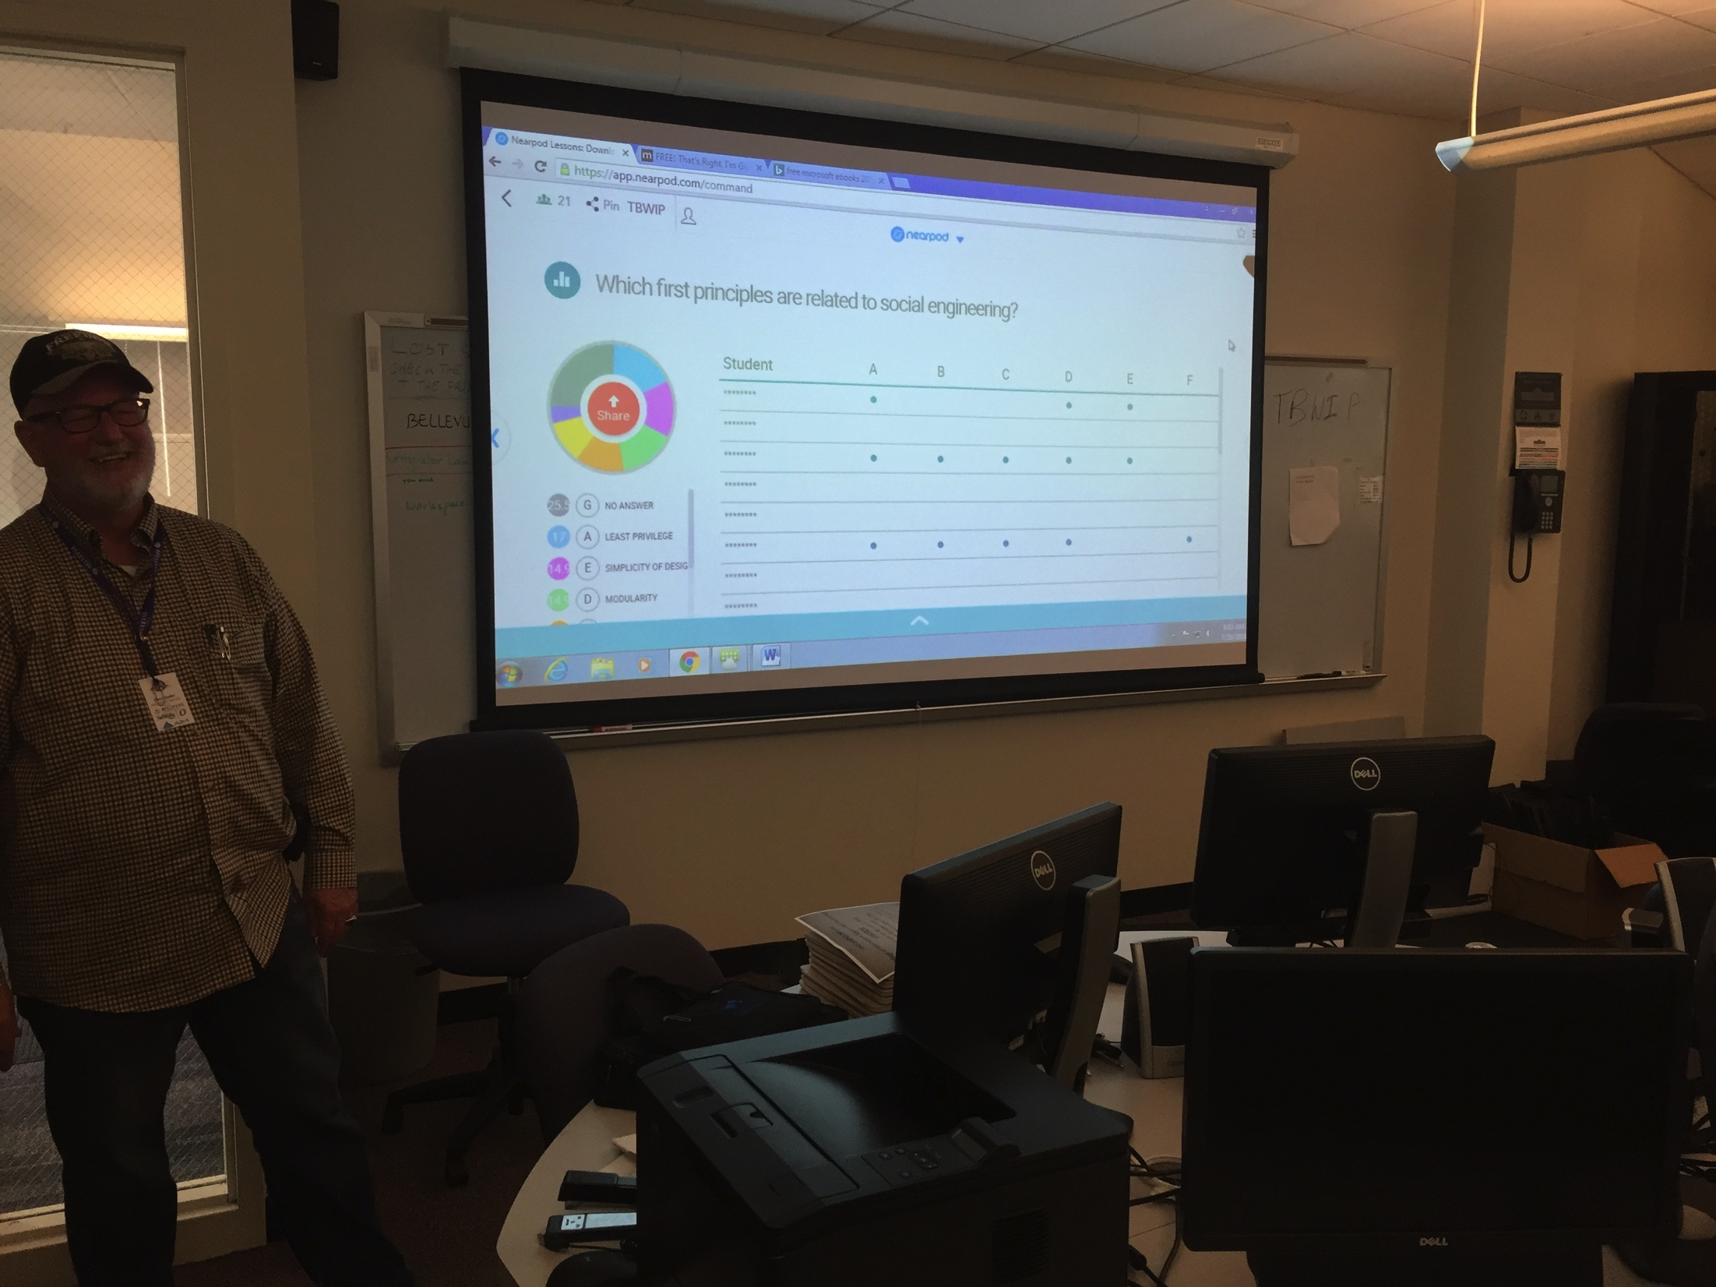
NearPod

Slide 25
Challenge Project
You have just completed an nmap scan of your network looking for potential vulnerable systems. The nmap results are in the file nmap.gnmap
Write a python script to print out
The IP addresses of the two domain controllers
Which host is running a website

Slide 26
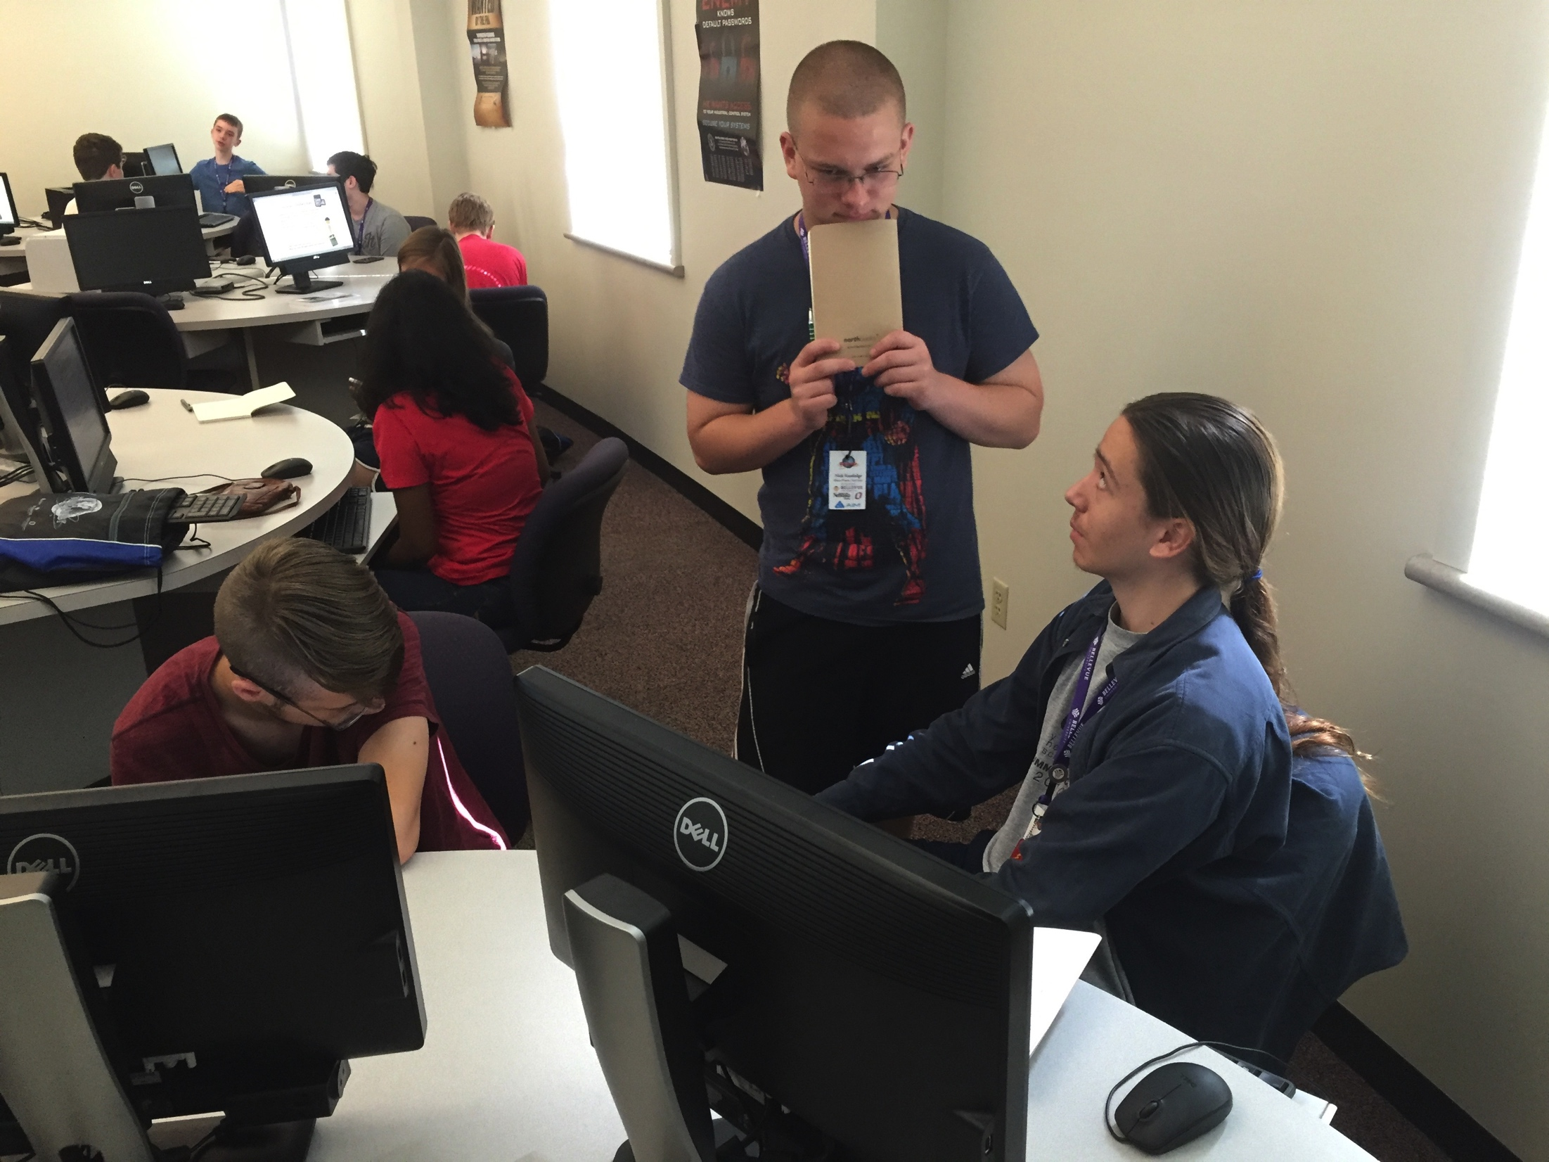

Slide 27
HELP!!!!
Just when you thought it was safe to take a break you've found out that Claire, your lead programmer got lost on the way to work playing Pokemon GO. She developed a program to encrypt the company's lunch menu with a Caesar cipher. Unfortunately, she never completed the decrypting program and the cafeteria is serving blanched brussels sprouts today, no one wants to get in that line. You've been recruited to write a decrypting algorithm, and…oh yea, no one knows the key.

Slide 28
Found Code
#! /usr/bin/env python3
ALPHABET = "abcdefghijklmnopqrstuvwxyz"
def caesar (word, key):
encoded = ""
for ch in word:
if ch in ALPHABET:
index = ALPHABET.find(ch)
nextIndex = (index + key) % 26
encoded += ALPHABET[nextIndex]
else:
encoded += ch
return encoded
pfiggszg gdfcihg cb zwbs gwl.

Slide 29
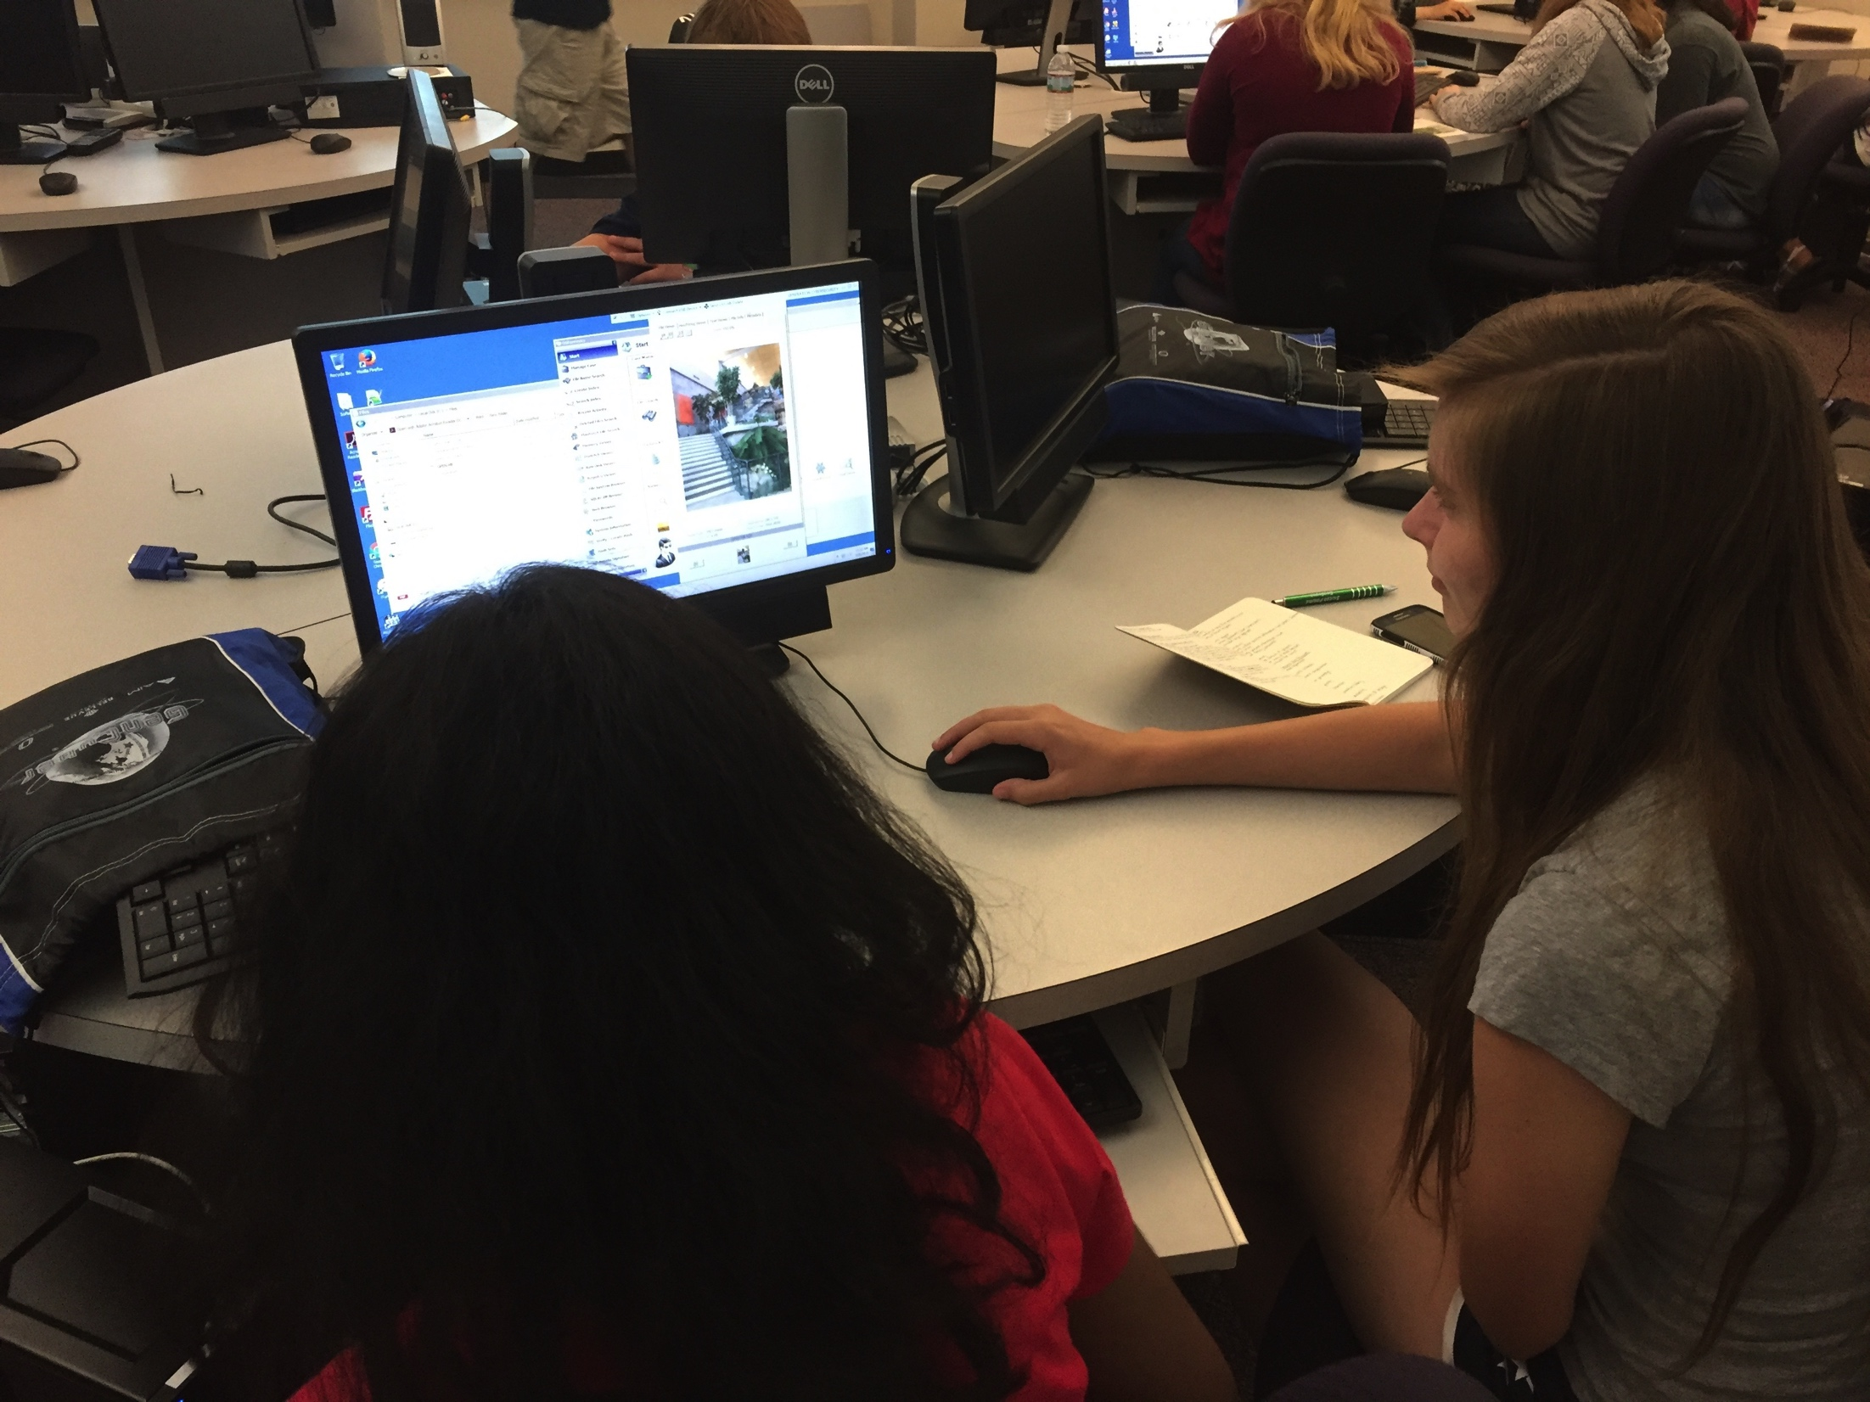

Slide 30
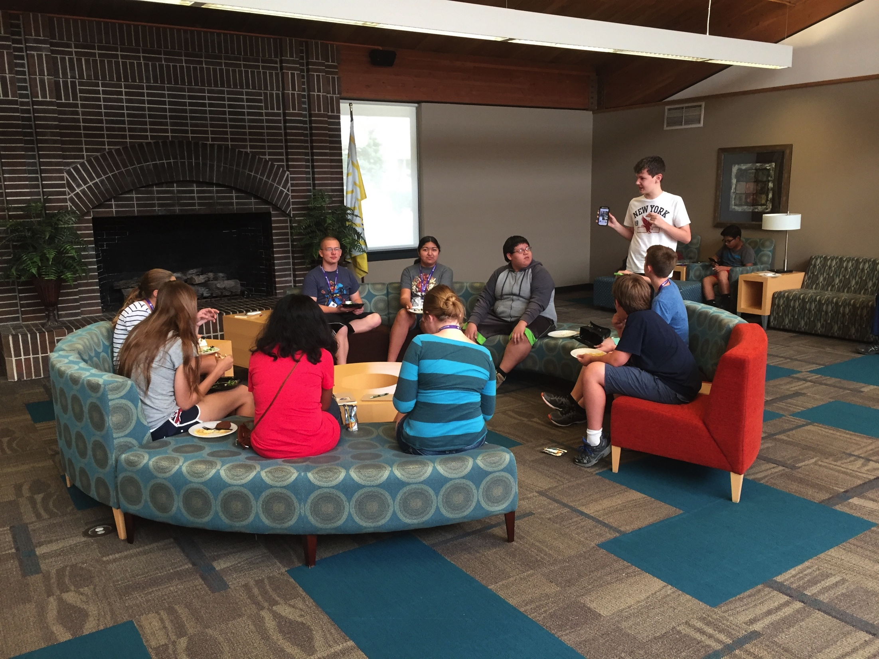
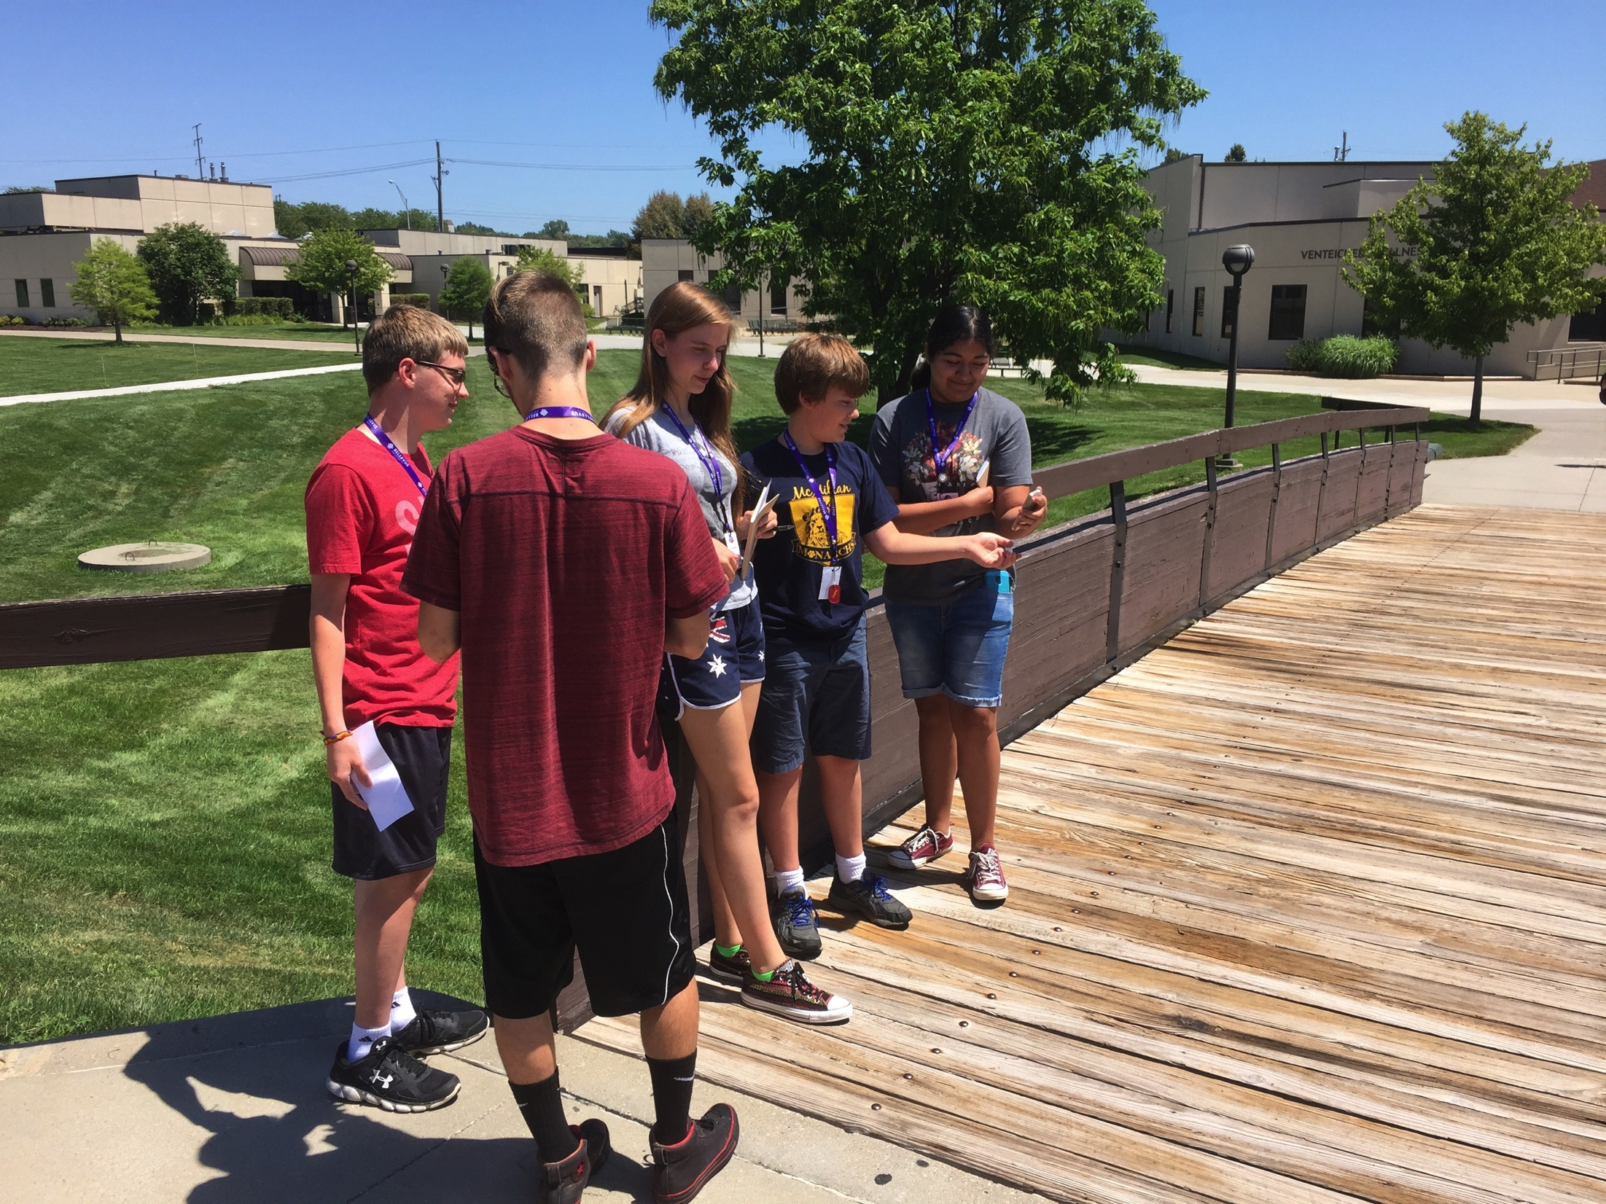
(Informal) Feedback

Slide 31
(Informal) Feedback
I never knew that’s how those worked (linux file permissions)
I can’t believe we get to do this all week, I should have done camps before
So I could take that example and write my own program to both encrypt and decrypt messages? (Caesar Cipher)
How do we get Cyberpatriot at our school?
What websites can I work on at home to learn Linux and Python?
Is it lunch already?

Slide 32
Silicon Prairie Gencyber
Questions?

